Slide 1
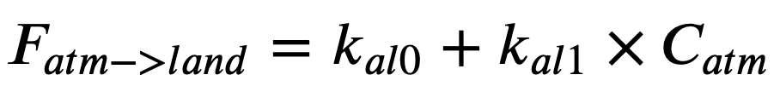
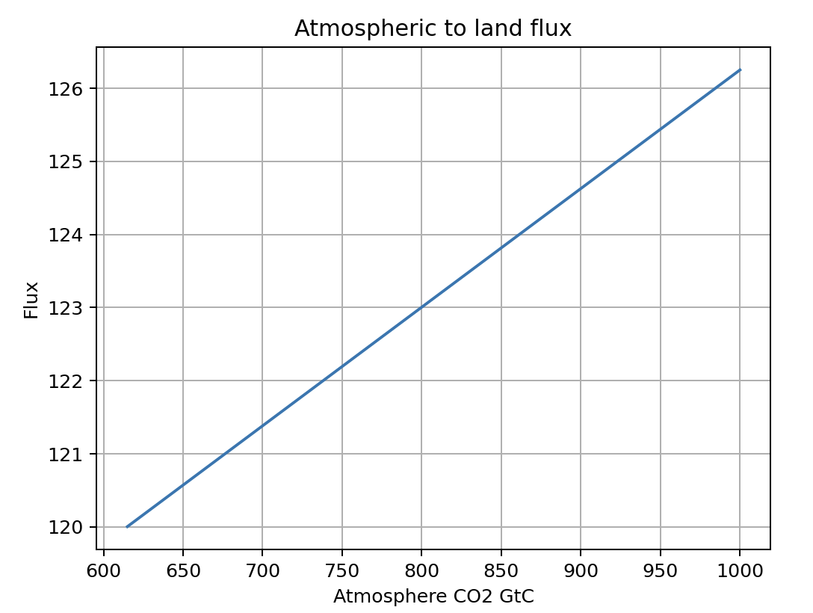
Some issues with Python syntax I’ve noticed in regards to the atm->land flux

Slide 2
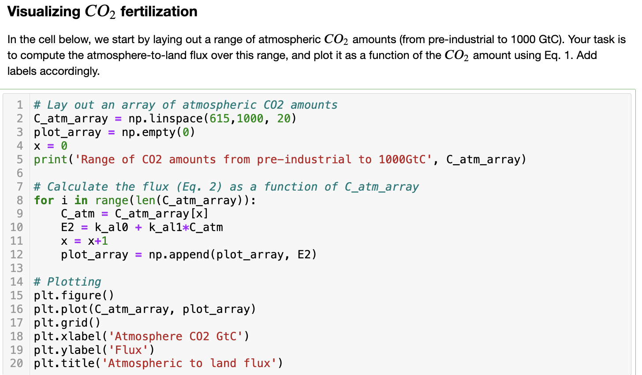
Can you tell what the problem is here?

Slide 3
Can you tell what the problem is here? This is needlessly complex and prone to typos

Slide 4
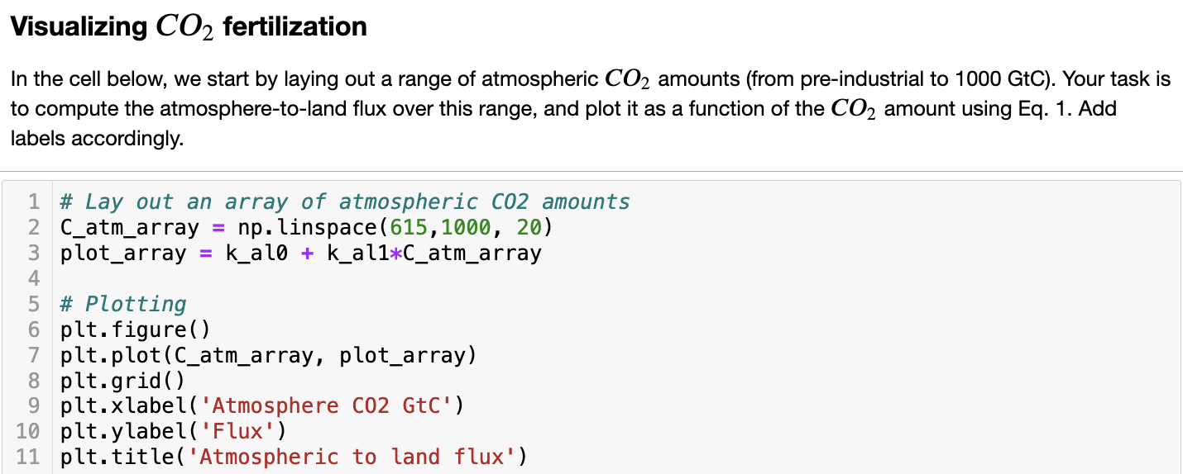
Can you tell what the problem is here? This is much more compact and secure

Slide 5
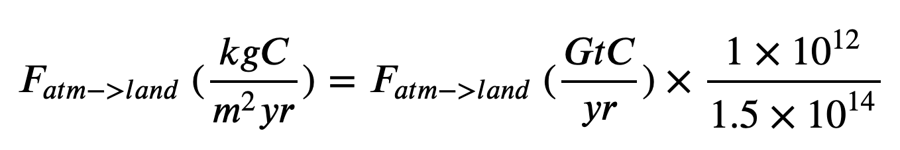
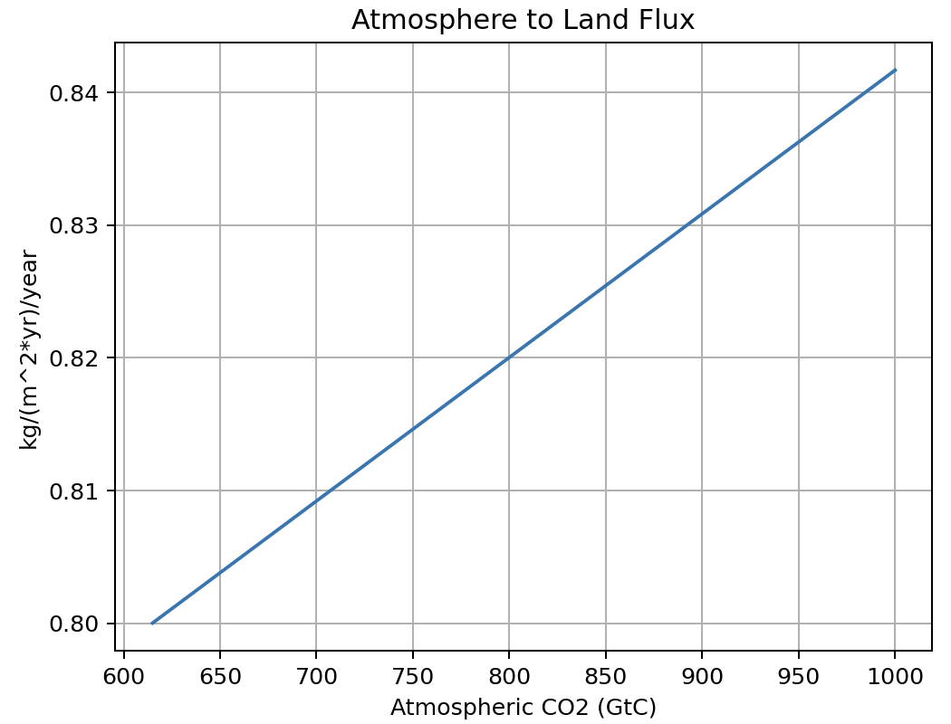
Another issue has to do with the conversion to kg/m²/year
(kgC/m²/yr)
(GtC/yr)

Slide 6
Another issue has to do with the conversion to kg/m²/year
F_al_converted = …
F_al*10**12/1.5*10**14
F_al*10**12/(1.5*10**14)
F_al*1e12/1.5e14
(kgC/m²/yr)
(GtC/yr)

Slide 7
Another issue has to do with the conversion to kg/m²/year
F_al_converted = …
F_al*10**12/1.5*10**14
F_al*10**12/(1.5*10**14)
F_al*1e12/1.5e14
(kgC/m²/yr)
(GtC/yr)

Slide 8
Another issue has to do with the conversion to kg/m²/year
F_al_converted = …
F_al*10**12/1.5*10**14
F_al*10**12/(1.5*10**14)
F_al*1e12/1.5e14
(kgC/m²/yr)
(GtC/yr)

Slide 9
Another issue has to do with the conversion to kg/m²/year
F_al_converted = …
F_al*10**12/1.5*10**14
F_al*10**12/(1.5*10**14)
F_al*1e12/1.5e14
(kgC/m²/yr)
(GtC/yr)

